Slide 1
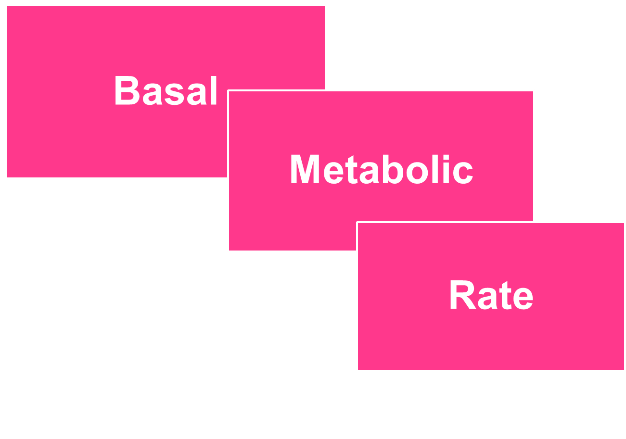

Slide 2
Metabolic reactions in the body is of 2 types:
1- Anabolic reaction :
These include the chemical reaction involved in synthesis of new intracellular constituents.
Required for growth and maintenance of cells .

Slide 3
2- Catabolic reaction :
include the chemical reaction involved in oxidation of various organic food stuffs (CHO ,fats & proteins ) to release their chemical energy.
75-80% of chemical Energy appears as thermal energy (heat).
20 -30% of released chemical energy is stored in certain organic phosphate compounds specially ATP.

Slide 4
ATP is energy for many cellular functions.
ATP librates 12000 calorie/mole in the physiological conditions.
Biochemichal reactions use less than 12000 calories and reminder loss as heat.
It is essential for normal body functions to maintain a constant ATP concentration.

Slide 5
USES of ATP
1- production of cellular components like proteins
2- muscule contraction.
3- active transport across cell membrane.
4- glandular secretion.
5- nerve conduction.

Slide 6
Energy Reactions
1-Aerobic Energy
Is energy that can derived from food only by oxidation.
** oxidation is a process in which a chemical substance changes because of the addition of oxygen

Slide 7
2- Anaerobic energy
Is energy derived from food without oxygen consumption.
Carbohydratates are the best source of energy under anaerobic condition.

Slide 8
During strenuous muscular activty the sources of energy are
1- stored ATP
2- Phosphocreatine
3- anaerobic energy from glycolytic breakdown of glycogen into lactic acid.
4- aerobic energy released continuously from oxidative processes.

Slide 9
The first three sources particularly the anaerobic glycolsis are the energy sources during this type of activty.
But it is enough for 1-2 minutes not more.

Slide 10
After aperiod of strenuous exercise the preson continues to breath hard for minutes.
The excess consumption of oxygen after the execise is the
Oxygen Debt

Slide 11
Metabolic Rate
The rate of energy produced by the catabolism of food in the body per unit time
Is the same as the amount liberated when food is burned outside the body.
This energy is used for maintenance of body functions, digesting and metabolizing food, thermoregulation, and physical activity.

Slide 12
It appears as external work, heat, and energy storage:
Energy output=External work+Energy store + Heat

Slide 13
Calorie
The amount of heat energy necessary to rise the temperature of 1g of water one degree centigrade (from 15 to 16 c)
The stander unit of the heat energy is the calorie (cal), (kilocalories ; kcal).
1 kilocalorie; kcal, equals 1000 cal.

Slide 14
Basal Metabolic Rate

Slide 15
Basal Metabolic Rate (BMR)
Definition:
The amount of energy produced per unit of time at basal conditions
Basal conditions (standerd):
1.Complete mental & physical relaxation (sleep 6-8 hours).
2.After 12 hours from the last meal.
3.Comfortable environmental temperature(25 oC).

Slide 16
At basal conditions energy is consumed to Maintain vital organs functions such as: beating of the heart , respiration, activity of the nervous system , Na-k ATPase pump.
Normal BMR 2000 kcal/day.

Slide 17
Measurement of BMR
1- Direct calorimetry
2- Indirect calorimetry
The amount of O₂ consumption per unit of time is proportionate to the energy produced by metabolism.
Measurement of O₂ consumption (indirect calorimetry) is used to determine the metabolic rate.

Slide 18
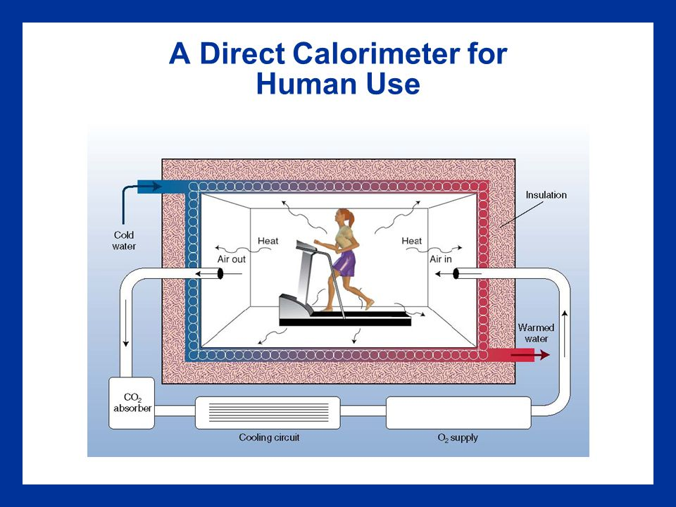

Slide 19
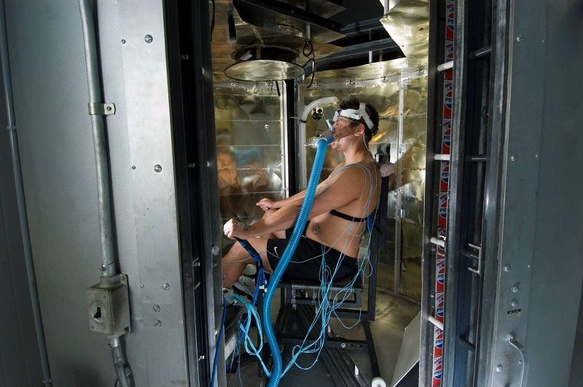

Slide 20
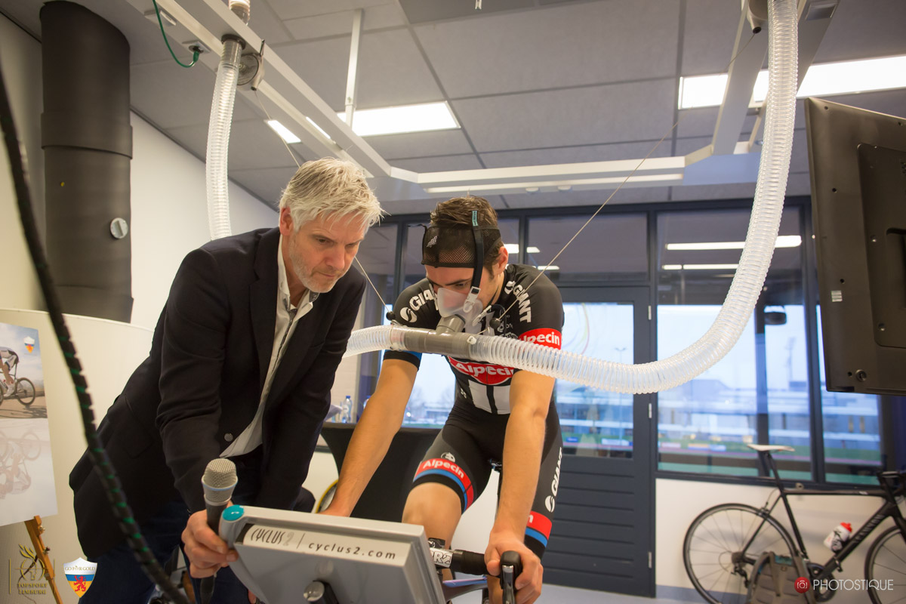
Indirect calorimetry

Slide 21
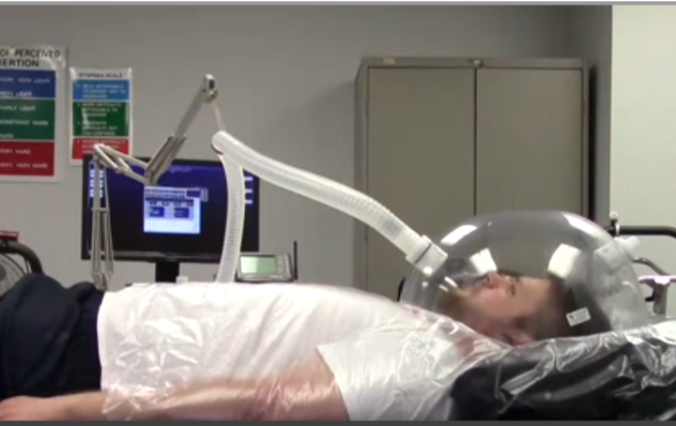

Slide 22
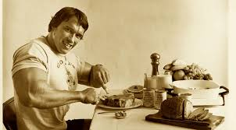
BMR falls by 10% during sleep and 40% during prolonged starvation.
The rate during normal daytime activities is higher than the BMR because of muscular activity and food intake.

Slide 23
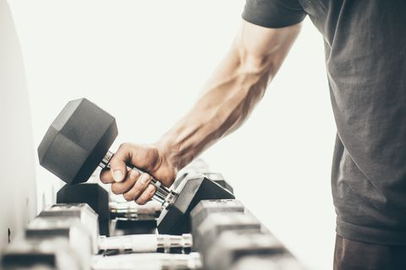
The maximum metabolic rate reached during exercise is often
said to be 10 times
the BMR.

Slide 24
Factors affecting BMR
Age:
Children > adults 1-2 times(rapid growth).
Gender:
Male > female by 7% , due to presence of a greater fat store which exert a little metabolic activity .
Pregnancy & lactation: has higher BMR

Slide 25
Con…
Factors affecting BMR
Food intake(specific dynamic action) after meal ingested MR increase
Muscular activity:
athletes have BMRs 10% higher than in other individuals due to greater muscle bulk & smaller amount of fat .

Slide 26
Factors affecting BMR
Anxiety and tension : these ↑ the BMR because they are associated with an ↑ in
-Epinephrine secretion
-The muscle tone Environmental temperature.
Climate : the BMR is about 10% higher in individual living in cold countries

Slide 27


